Slide 1
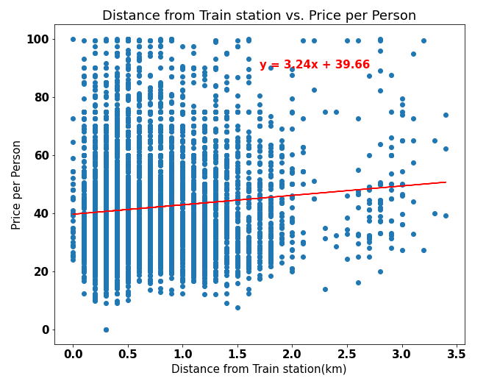
Correlations:
Earnings has a slight positive correlation with distance from train station
HYPOTHESIS:
(closer) Train proximity will increase earnings (approximate)
DATA INFERENCE:
Properties have increased prospective earnings as they are located further from the train stations

Slide 2
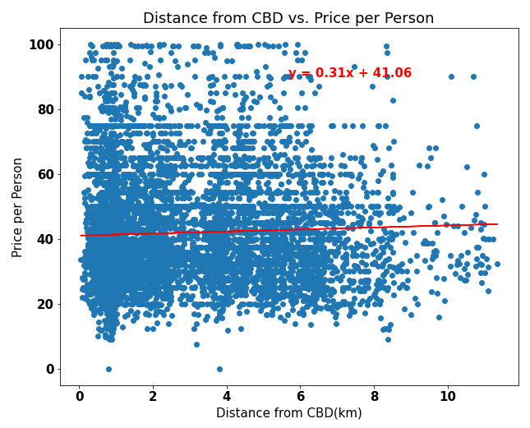
Correlations:
Price per person has a weak positive correalation with distance from CBD
HYPOTHESIS:
(Closer) Proximity to the CBD will increase earnings (approximate)
DATA RESULTS:
Approximate earnings increase slightly for properties located further from the CBD

Slide 3
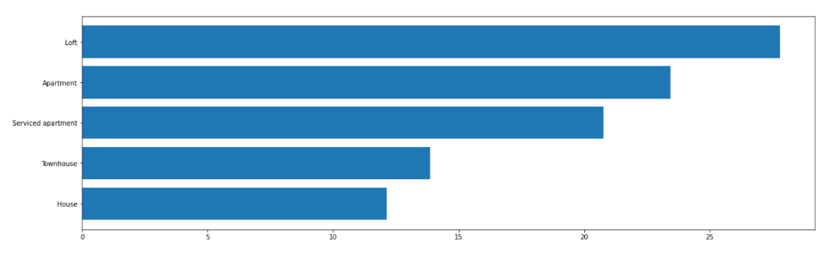
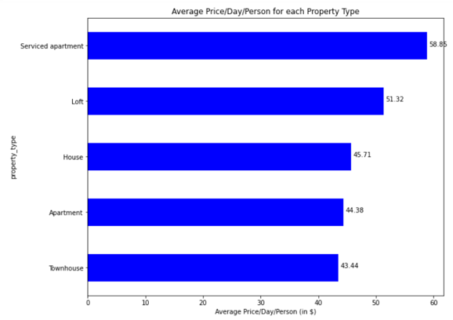
Correlations:
On property types there is no relationship between Popularity and prospective earnings
HYPOTHESIS:
Property types with highest earnings are the most popular ones
DATA RESULTS:
The data shows no correlation to prove that to be true

Slide 4
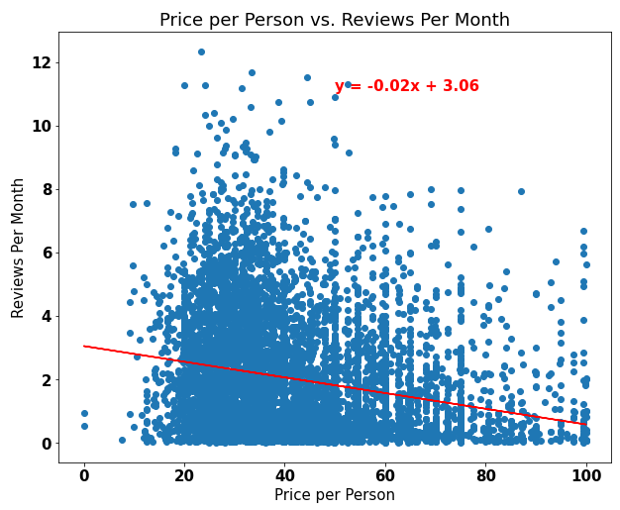
Correlations:
Popularity has a weak negative correlation with prospective earnings
HYPOTHESIS:
The Popularity of properties will be (positively) reflected in higher earnings
DATA RESULTS:
Listings with higher prospective earnings are less popular than listings with lower prospective earnings

